Slide 1

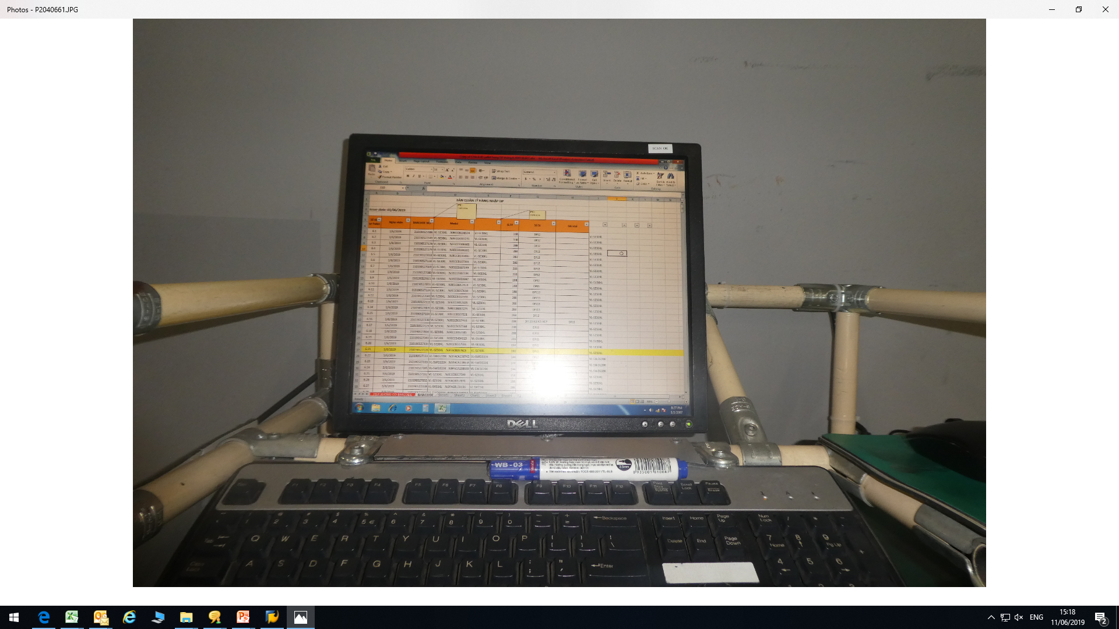
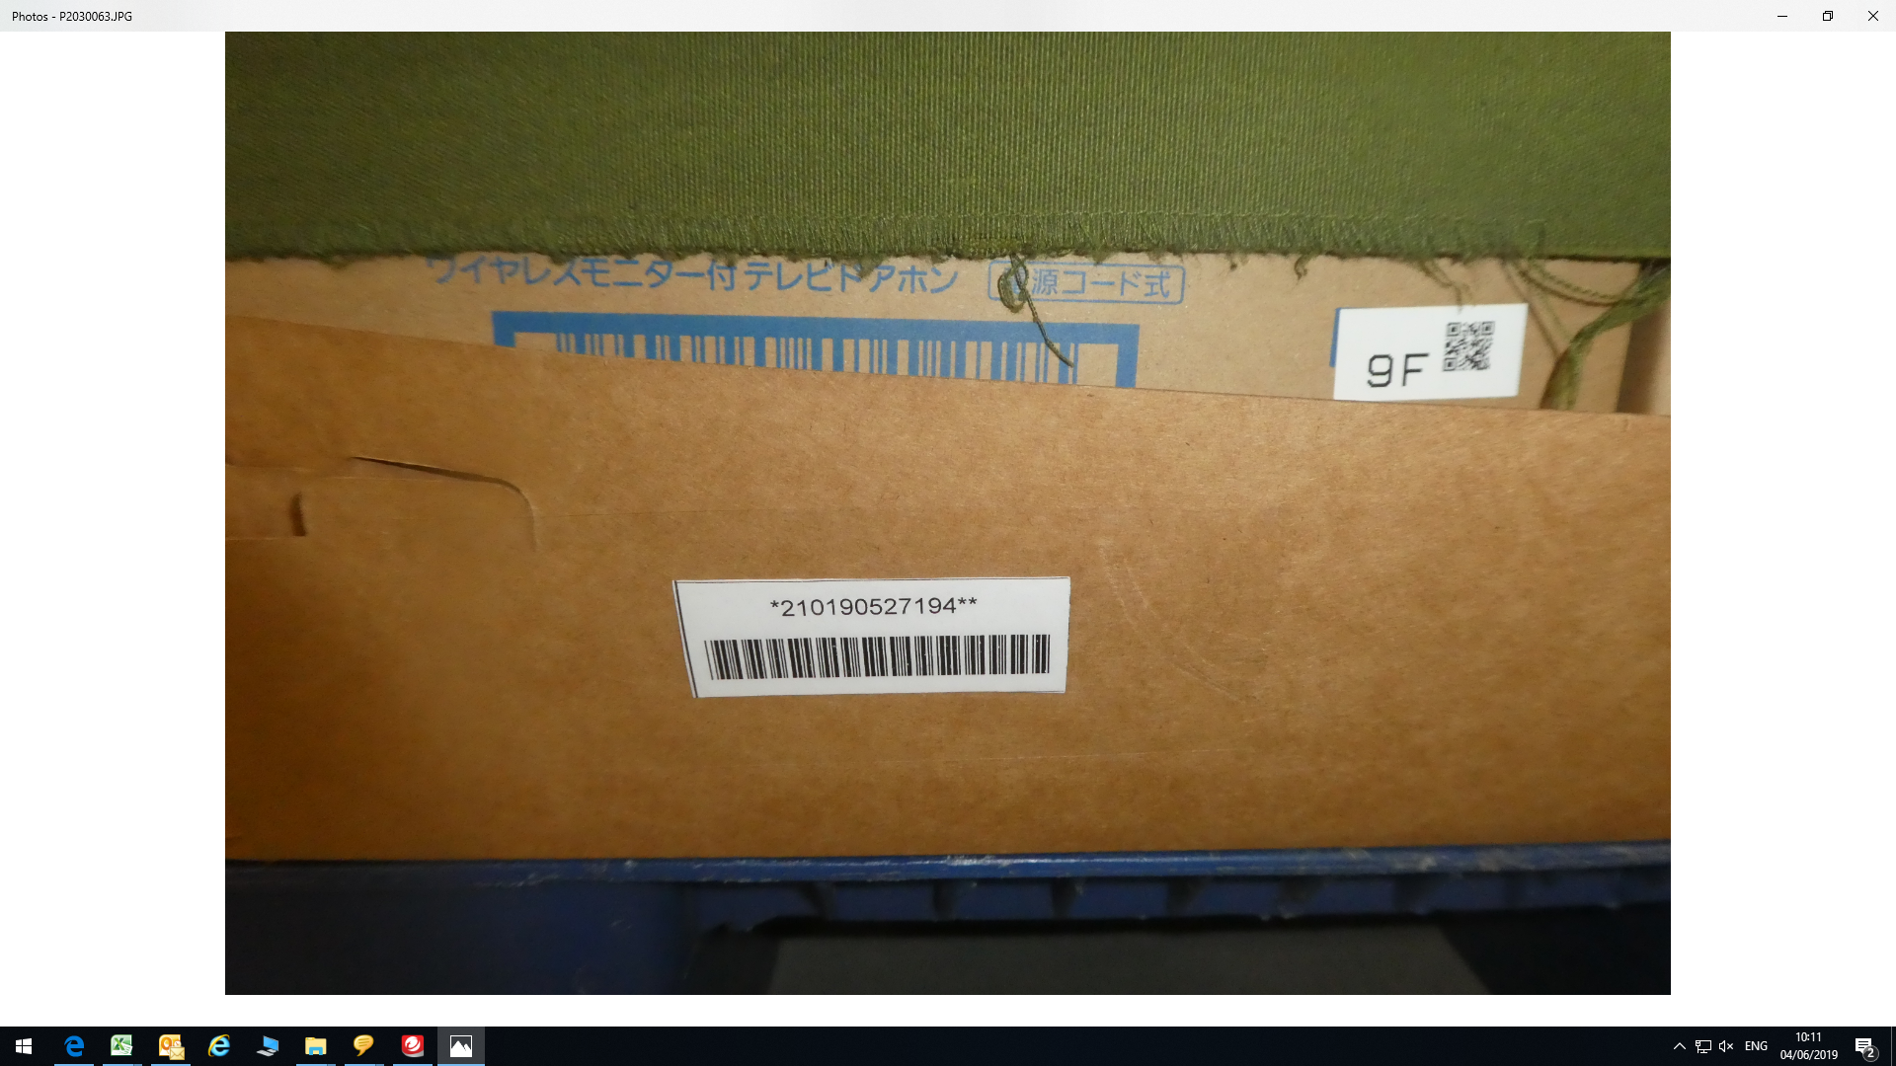
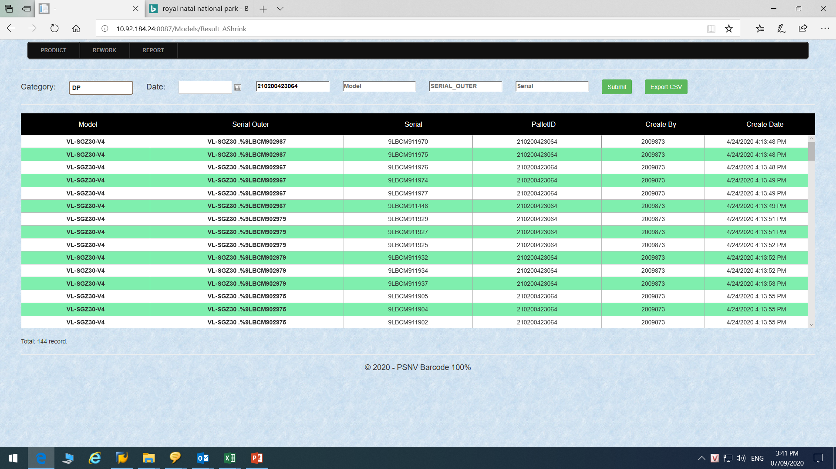
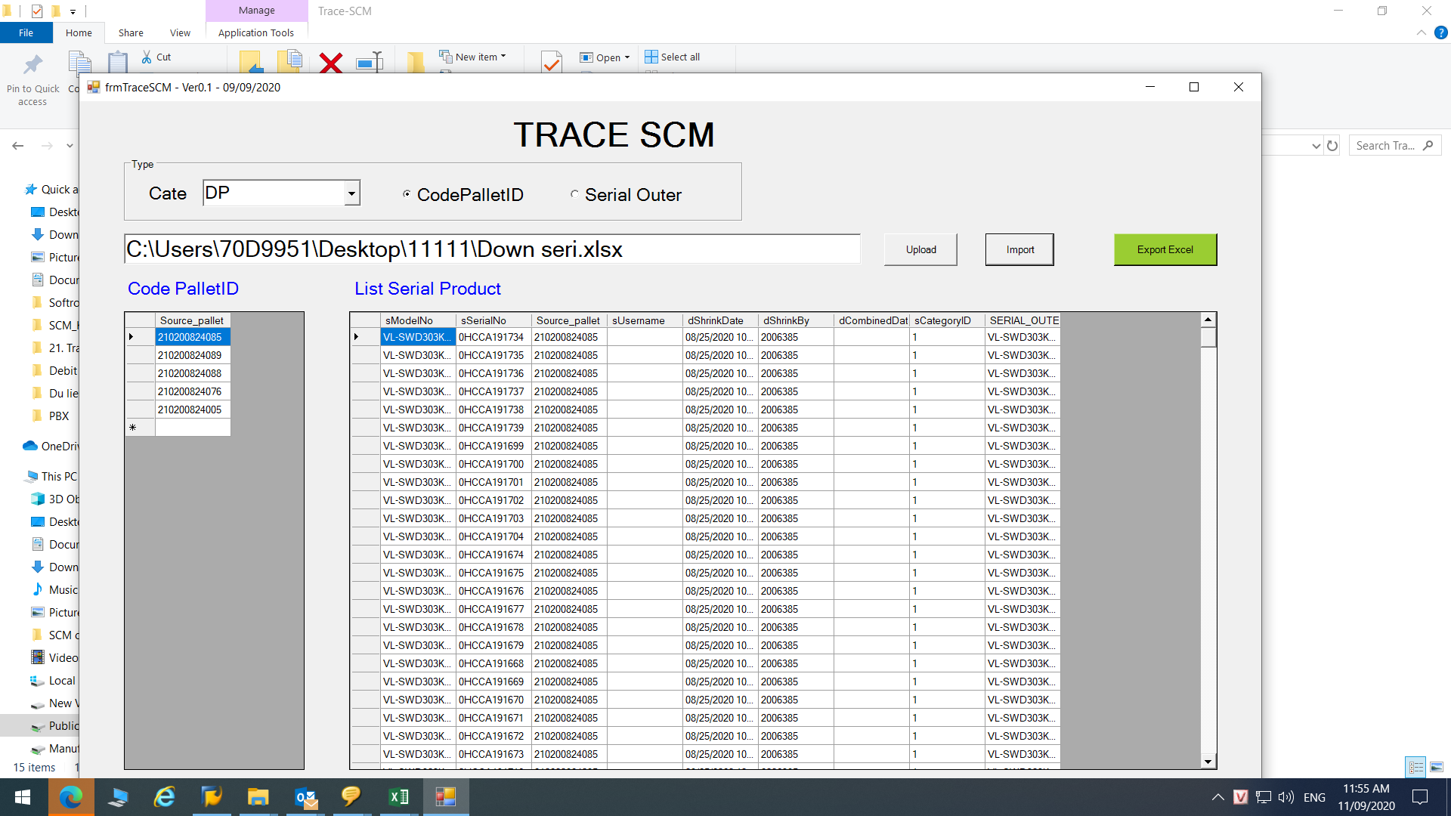
Develop new function to download serial by many barcode at once
Team: SCM-WH
PIC: Mr Cuong
Applied: Oct 2020
Investment: 0 USD
◆Before
◆ After
Download serial by only one barcode/ time
Download serial by many barcode at once
Request IT to develop a new function on system to download serial by many barcode at once.
=> Reduce time, cost for download serial from system.
Take time: 15 minutes/shipment ~ 900 minutes (15 hours)/60 shipment/month ~ 180hours/Year.
Save time: 540 hours – 180 hours = 360 hours/year
Save cost: 650 USD/Year
Download serial by only one barcode/ time.
Waste time : 1 minutes/ barcode ~ 45 minutes/shipment
~ 2700 minutes (45 hours)/60 shipment/month
~ 540 hours/year
.

